Slide 1
R Project Presentation Brice Eboule

Slide 2
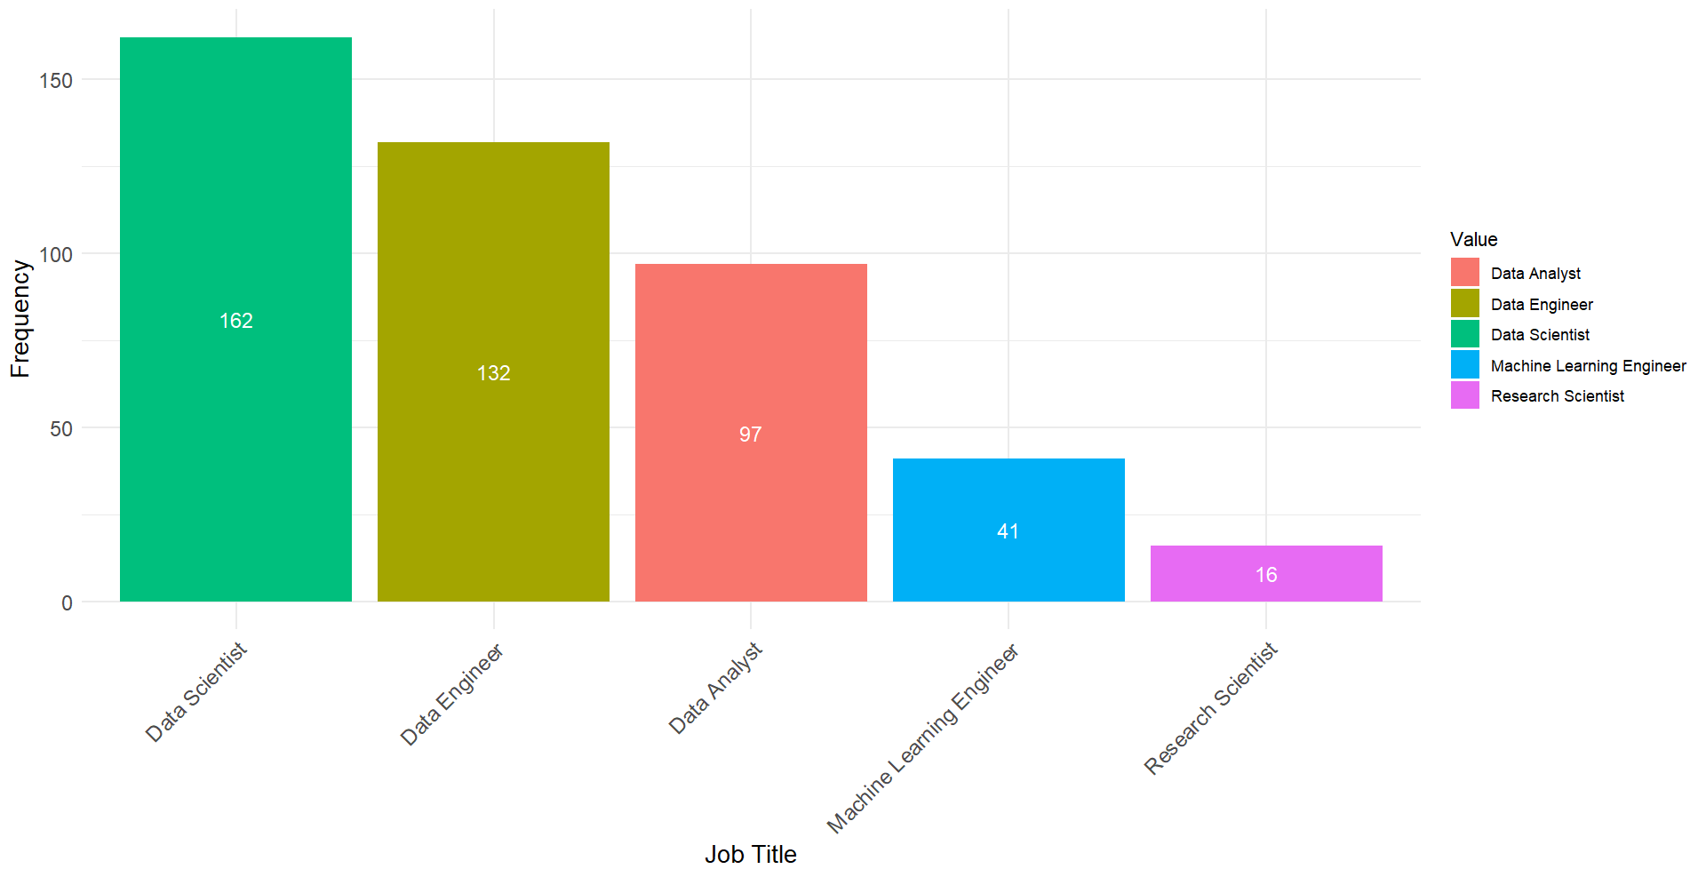
Job Titles (Top 5)

Slide 3
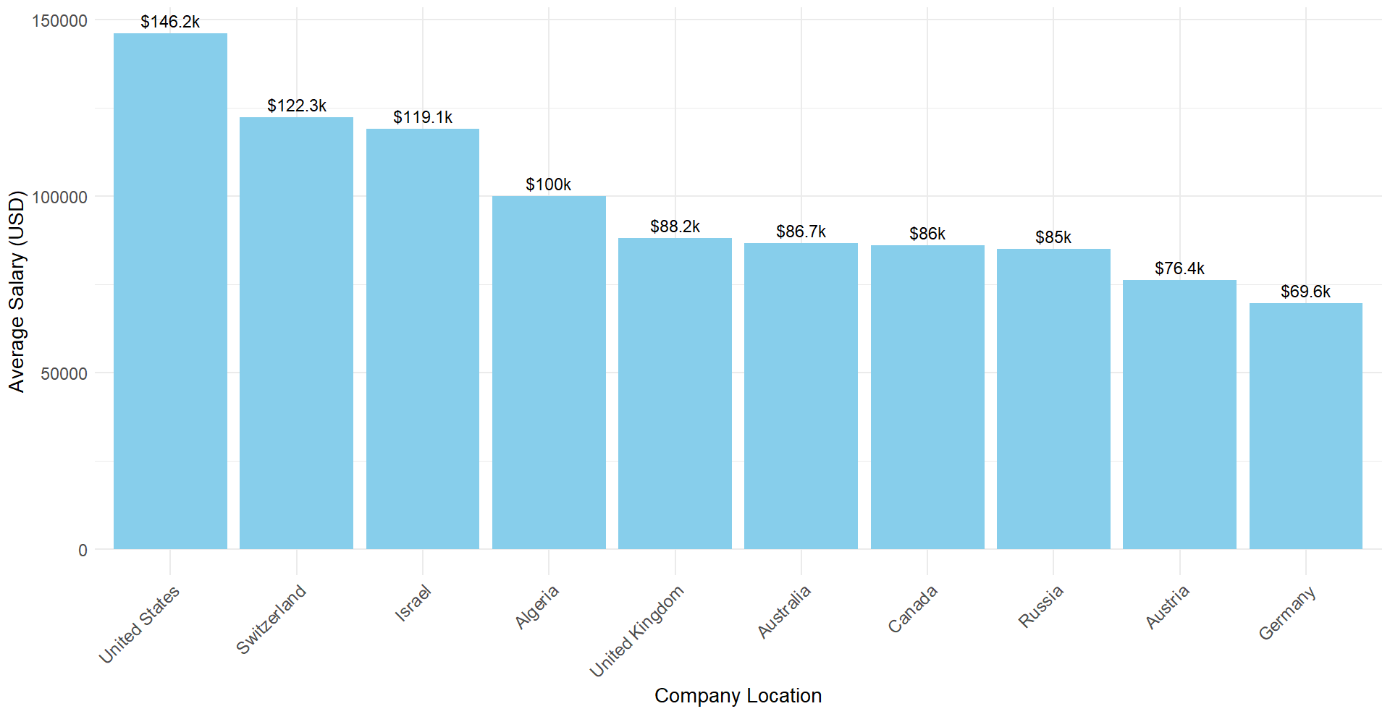
Best Company Location for Data Scientists

Slide 4
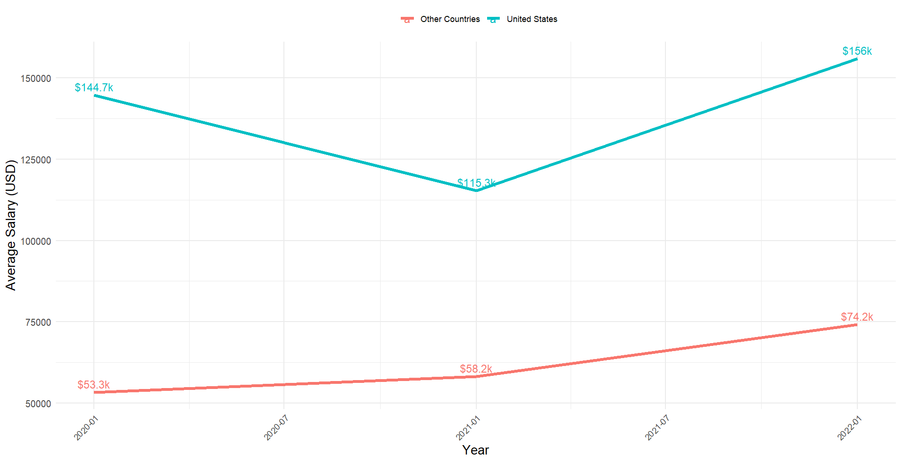
Average salary for Data Scientists Over Time

Slide 5
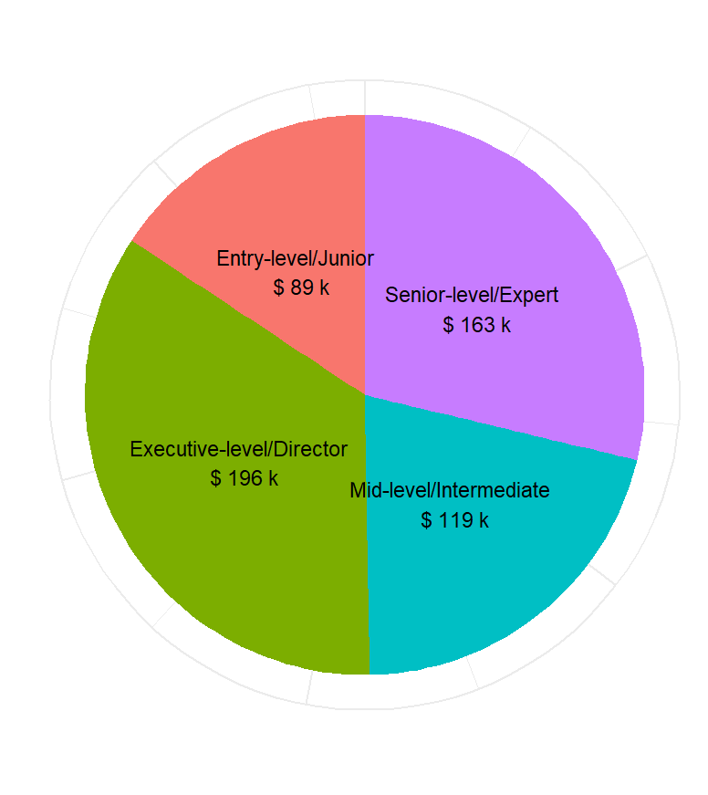
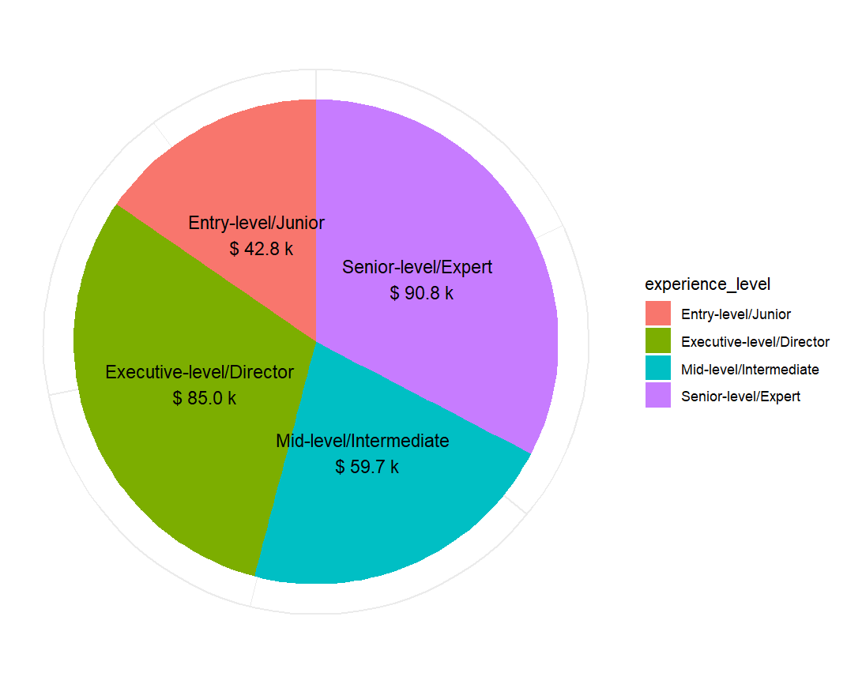
Average salary for Data Scientists based on Experience Level
United States
Other Countries

Slide 6
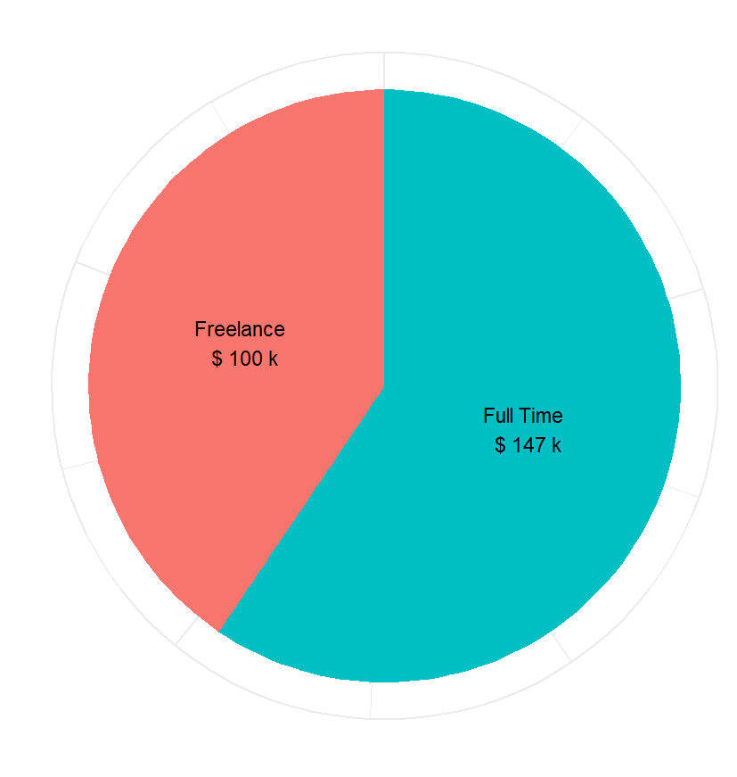
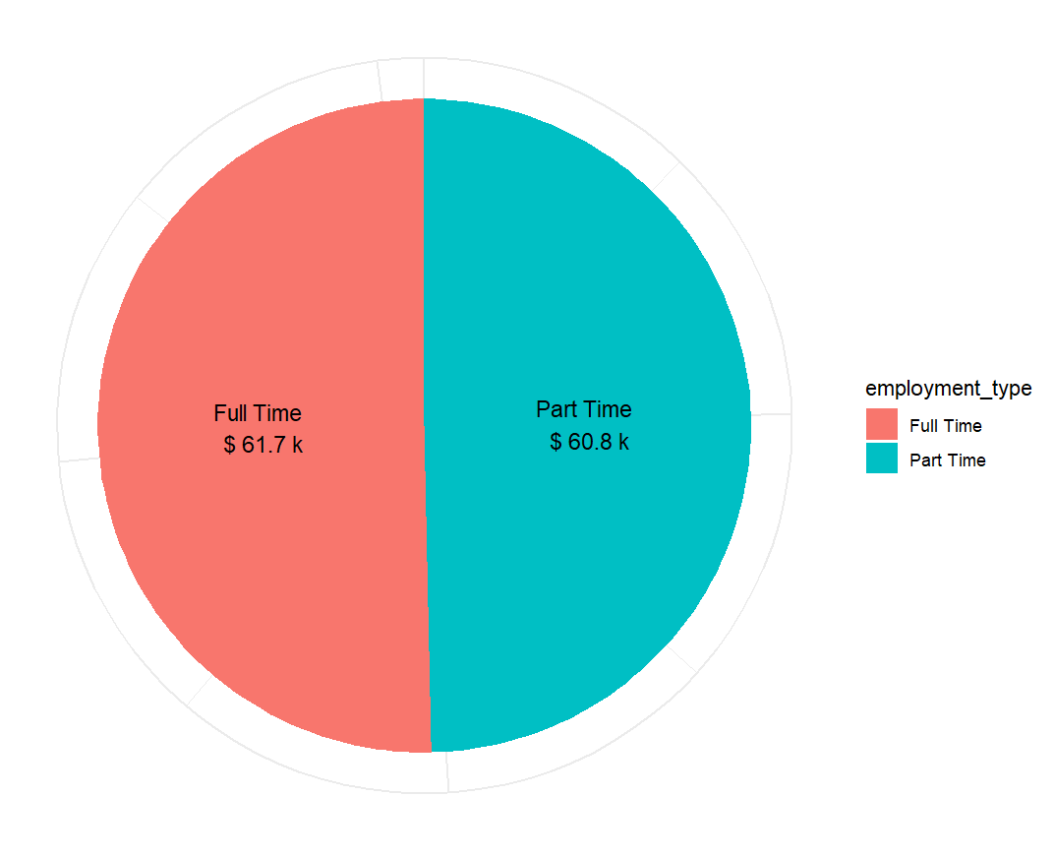
Average salary for Data Scientists based on Employment Type
United States
Other Countries

Slide 7
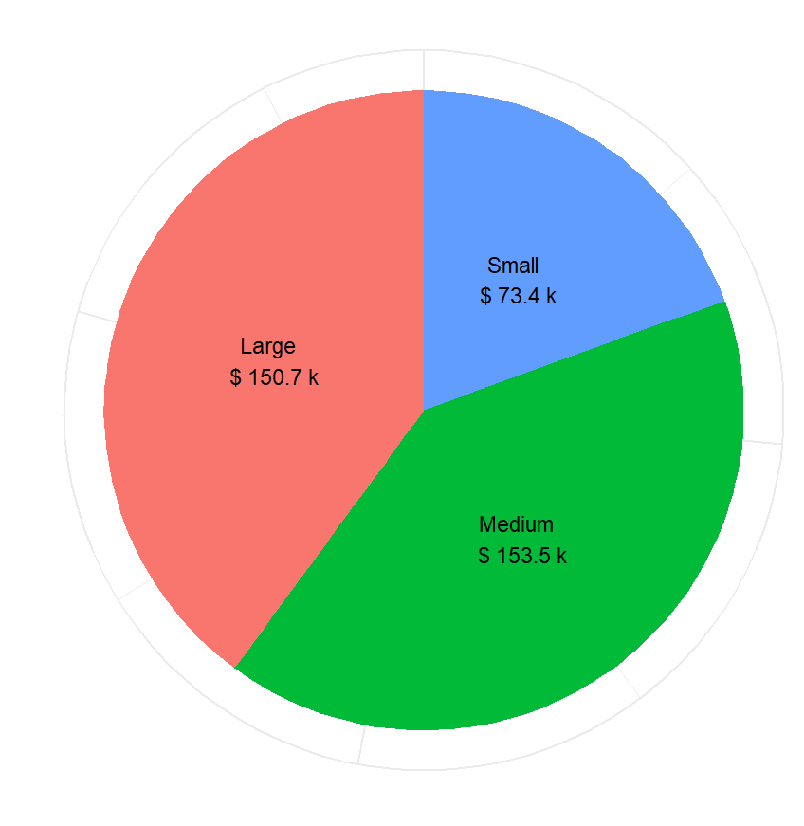
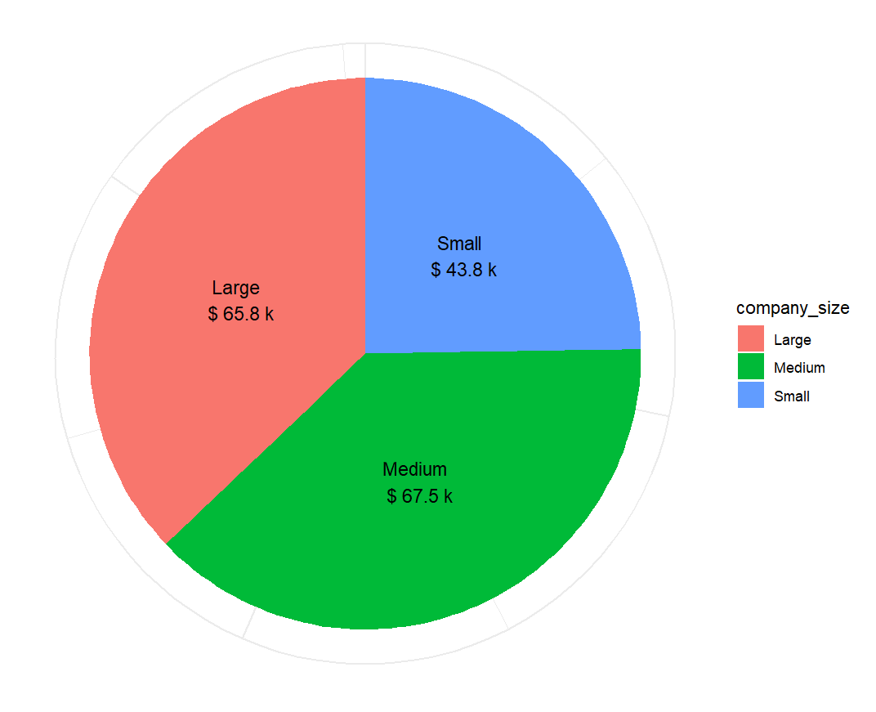
Average salary for Data Scientists based on Company Size
United States
Other Countries

Slide 8
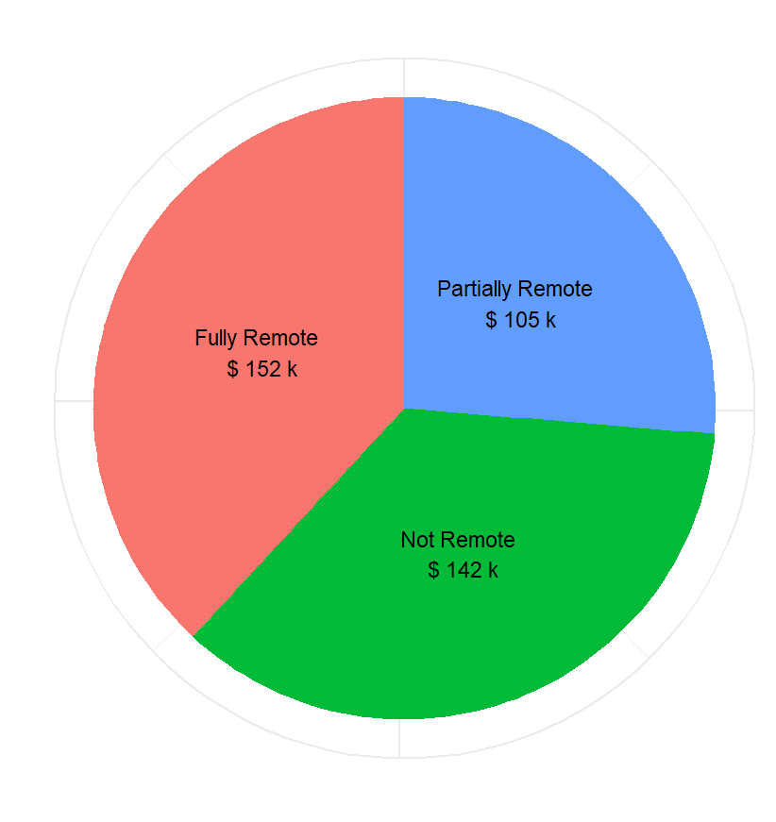
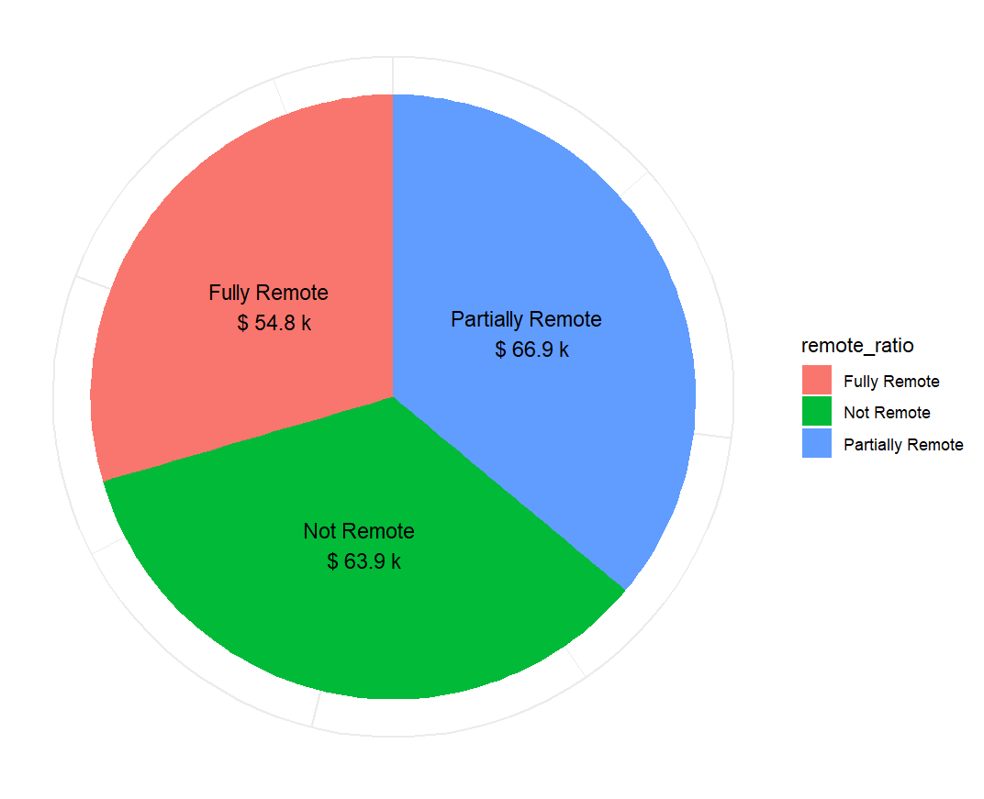
Average salary for Data Scientists based on Remote Ratio
United States
Other Countries

Slide 9
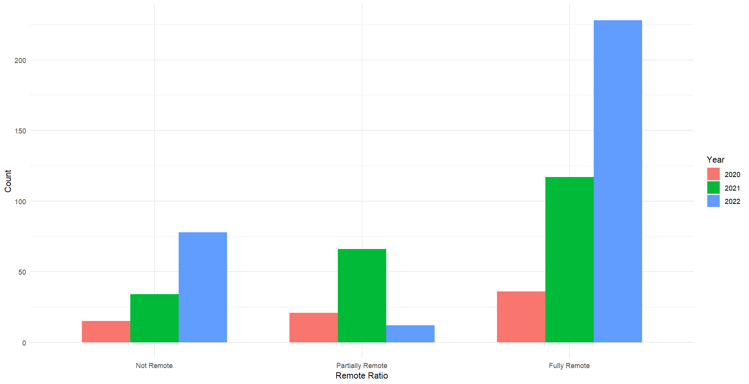
Change in Remote Ratio Over Time (2020-22)

Slide 10
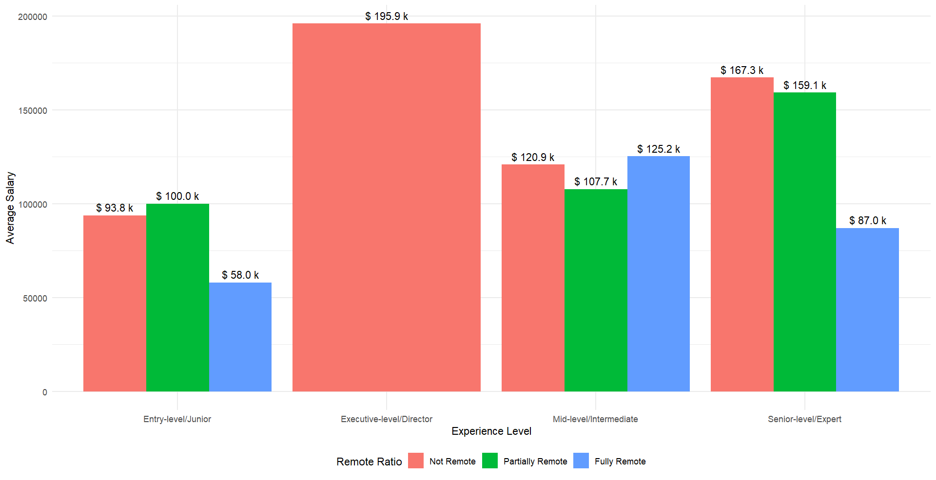
Average salary for Data Scientists based on Experience Level and Remote Ratio (United States)

Slide 11
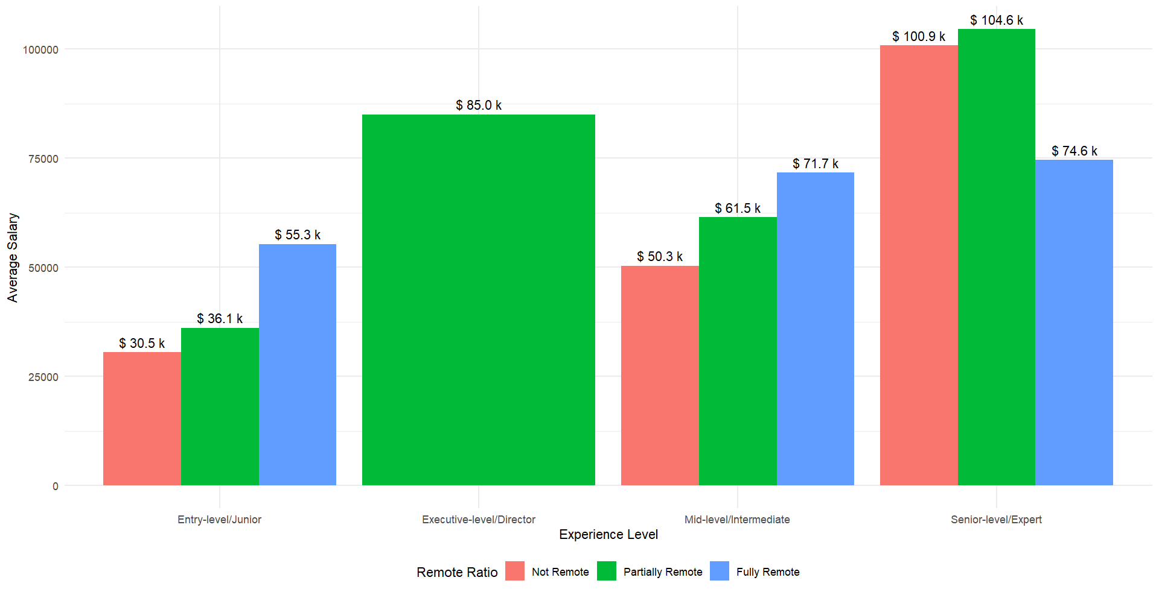
Average salary for Data Scientists based on Experience Level and Remote Ratio (other countries)

Slide 12
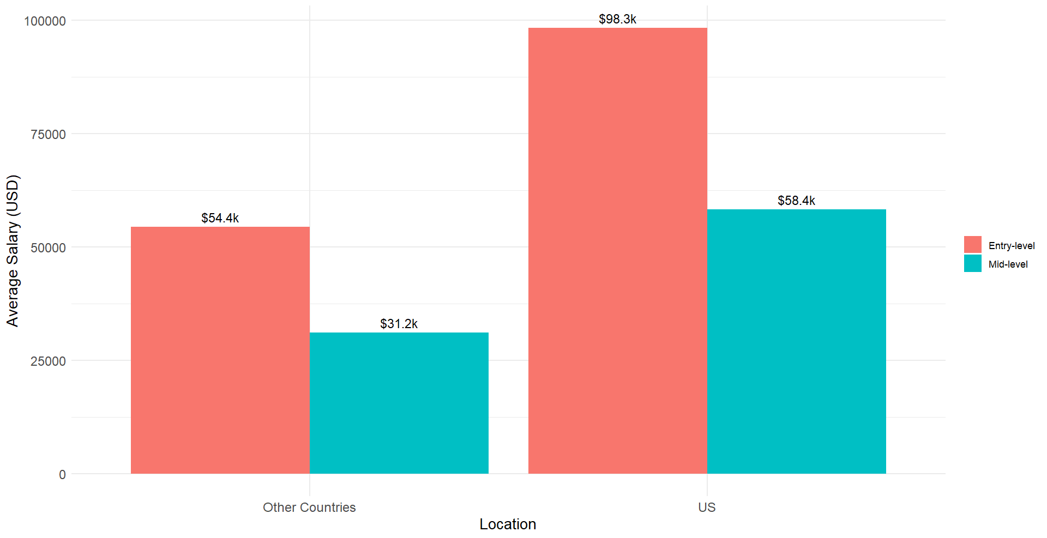
Average salary for Full Time Junior and Intermediate Level Data Scientists in Small Size Company based on Experience Level

Slide 13
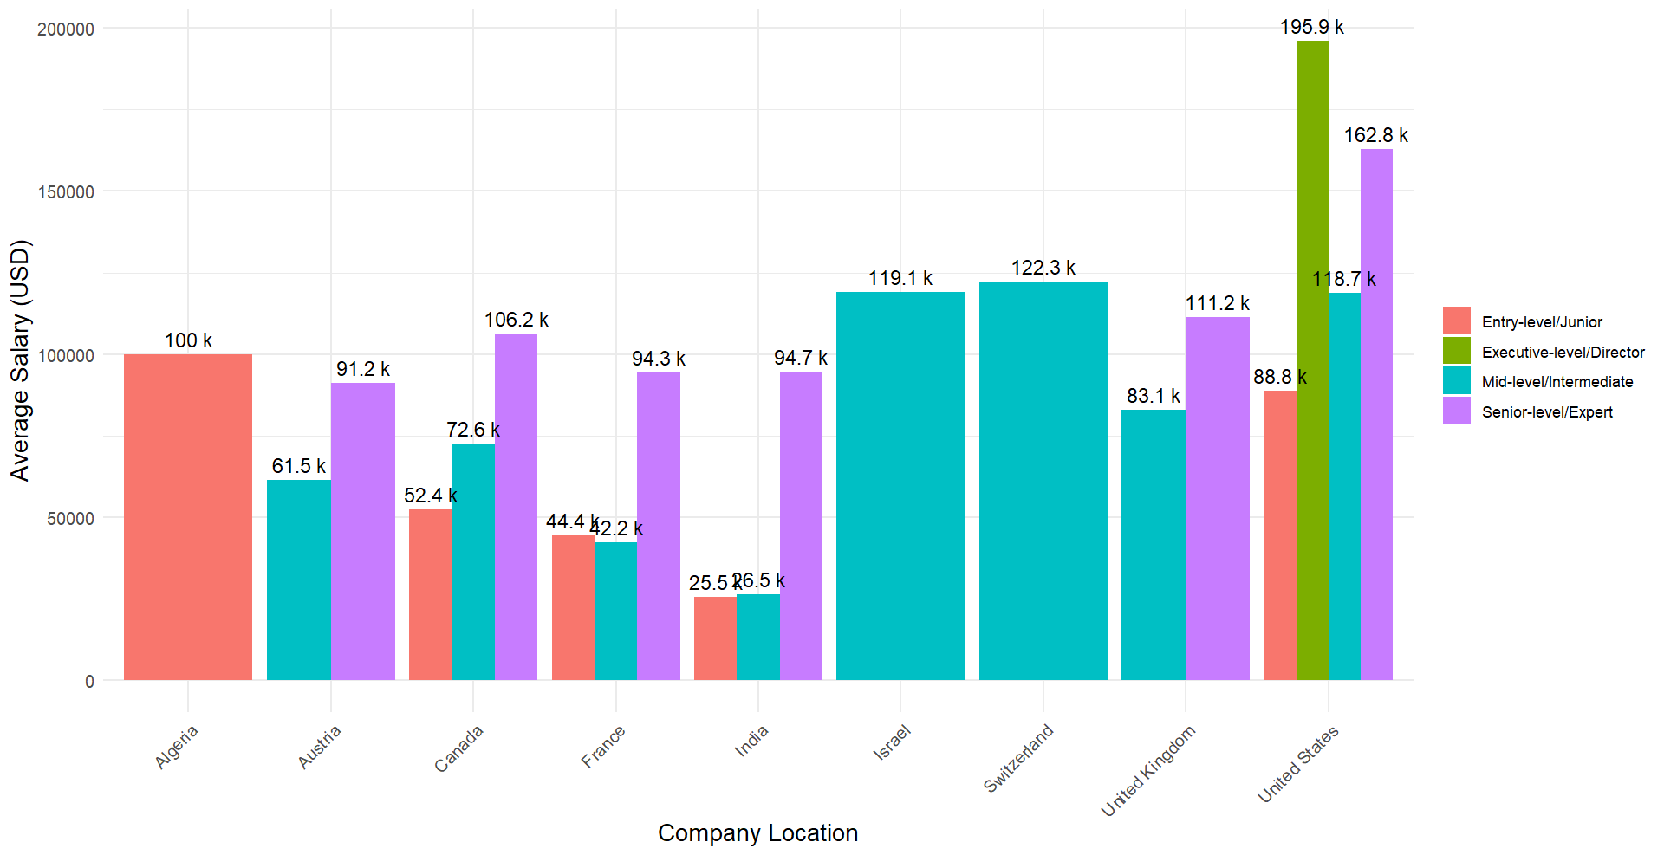
Average salary for Data Scientists in different countries based on Experience Level

